Slide 1
These PowerPoint slides summarize the results of inter-host SNPs analyses when reads in Japanese samples are compared with the outbreak reference sequences.
Slide 2 reproduces the Figure 3 in the current version of manuscript
Slide 3 shows data of Miyagi sapovirus GI.1 outbreak 2013_k9, Which was not previously included in Figure 3 of manuscript because of the lower breath of coverage, compared with other GI.1 outbreak samples (all had breath >85% after secondary mapping)
I think we need to show the overall ratio of synonymous and non-synonymous mutation for all 13 outbreak samples, and not only show data for 8 outbreak samples. In addition, it would be practically impossible to manually represent mutations in samples S63, s64 and s65 and include it to Figure 3.
I suggest that we add these figures as supplement figures to support figure 3, which should show the total number of mutations and the ratio Syn /Non_Syno

Slide 2
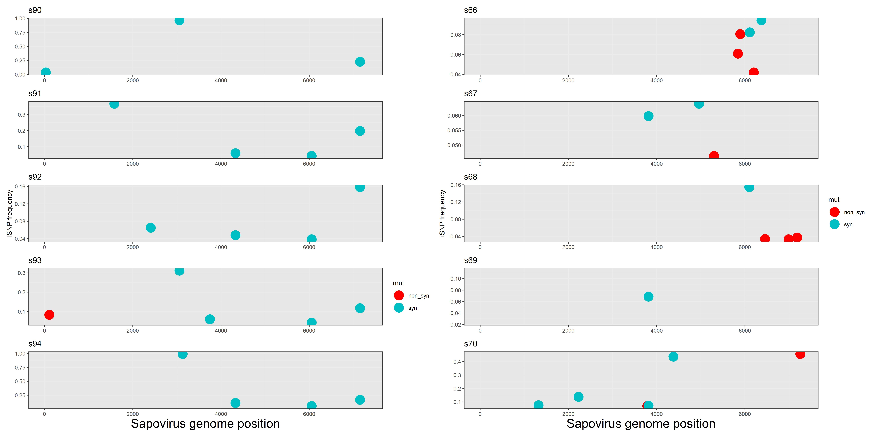
Sapovirus GI.1
Sapovirus GI.2
SNP Frequency in reads
mutation
Notes:
Mayuko sensei previously said all samples can not have the same mutation at the same position. That is not correct. It is possible, in the sense that these are virus populations, which may be descendents of same ancestor, and the outbreak reference is not necessarily the closest ancestral sequence.

Slide 3
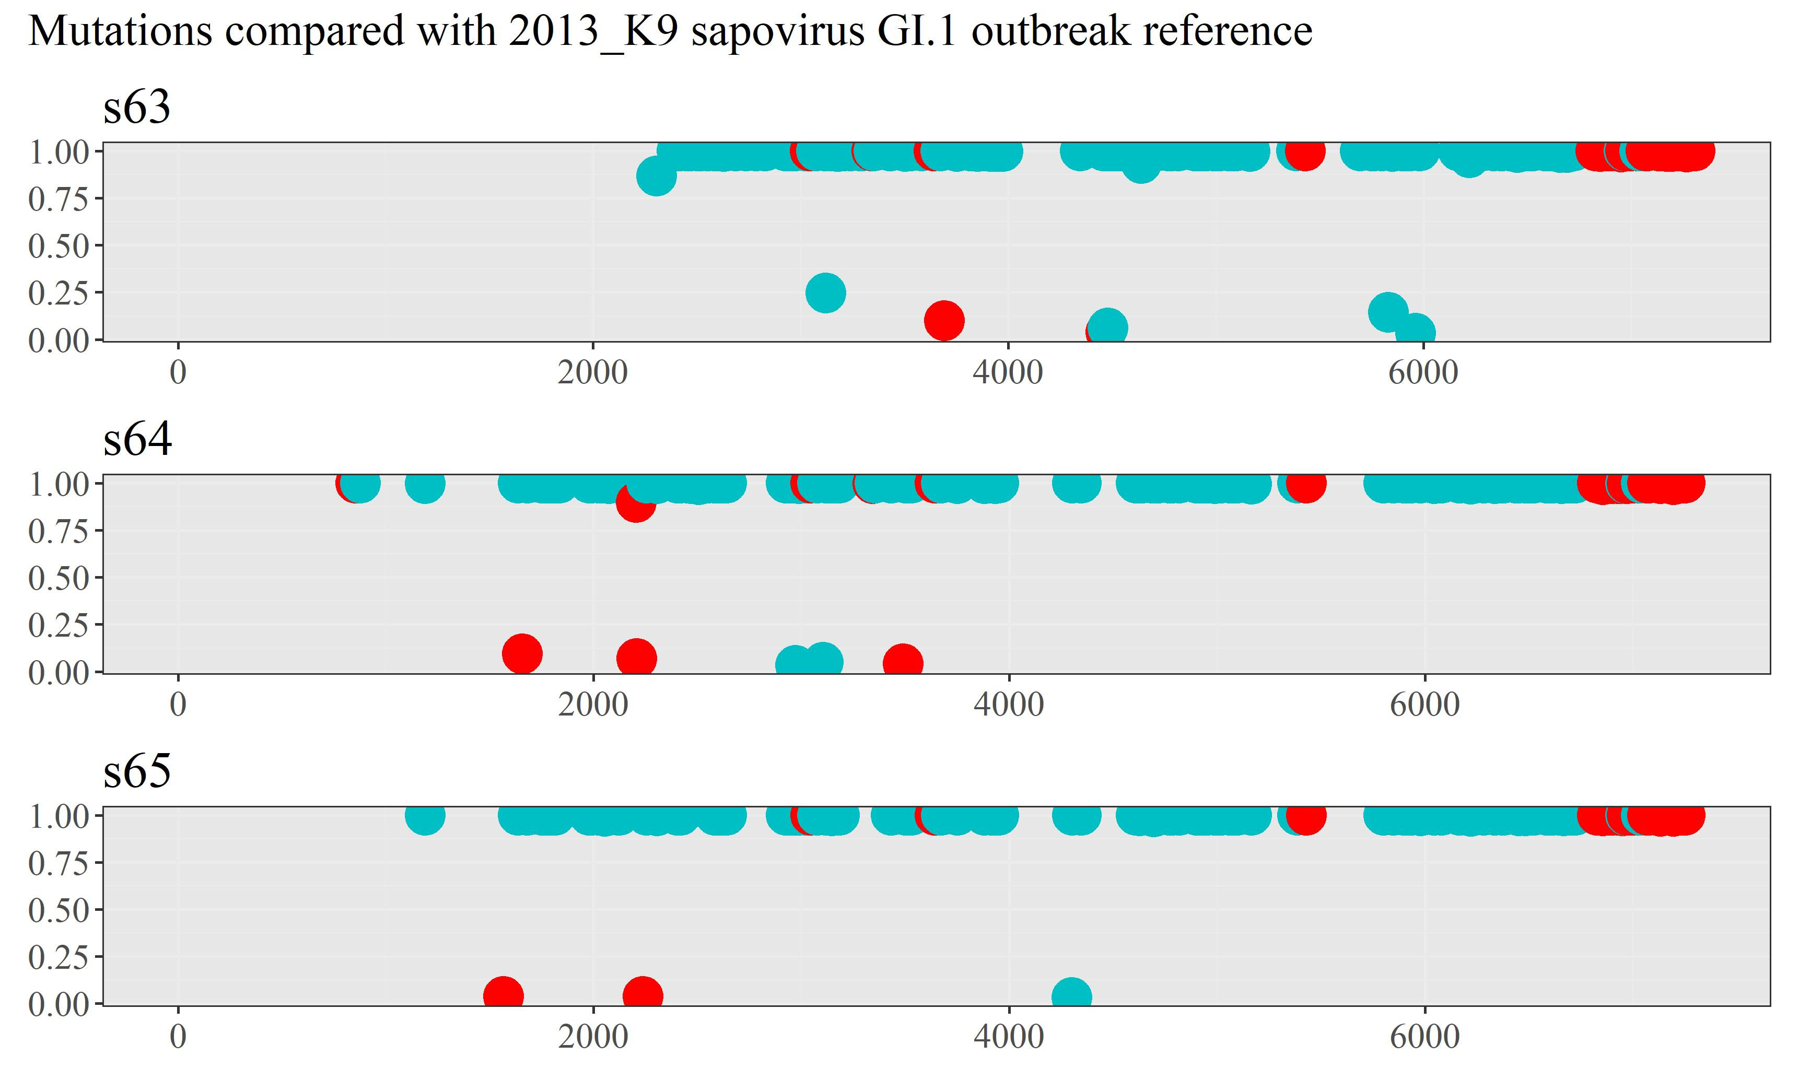
Sapovirus GI.1

Slide 4
Mayuko sensei previously said all samples can not have the same mutation at the same position. That is not correct.
It is possible, in the sense that when we analyze viruses at the sub-consensus level, each FASTQ file sequences from millions of virus populations, which may be descendants of same ancestor, and, most importantly, the outbreak reference is not necessarily the closest ancestral sequence to the sequences in FASTQ file

